Slide 1

Army STANDARD TRAINING PACKAGE
Notes:
Select Note Pages contain instruction comments to assist with your presentation.
This Standard Training Package (STP) is current as of July 2022. To ensure this is the most current version, please go to https://tjaglcs.army.mil/ and locate the STPs within the "Training" area/box of the tjaglcs site.

Slide 2
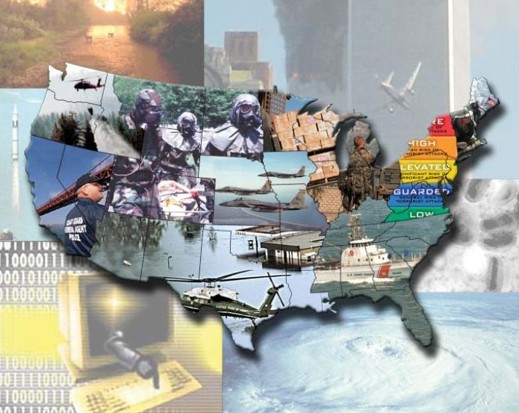
Defense Support of
Civil Authorities (DSCA)
Notes:
Select Note Pages contain instruction comments to assist with your presentation.
This Standard Training Package (STP) is current as of 15 March 2021. To ensure this is the most current version, please go to https://tjaglcs.army.mil/ and locate the STPs within the "Training" area/box of the tjaglcs site.

Slide 3
General Principles DSCA
Involvement by DoD in any domestic affair is the exception to the general rule
DoD’s involvement in DSCA is tightly controlled by statute and regulation
DoD will usually be subordinate to other civilian authority
Notes:
Instructor Comments
These are the overarching principles for DSCA

Slide 4
DoD’s VIEW
Homeland Security
Homeland
Defense
Defense Support
of Civil Authorities
Emergency Preparedness
Notes:
Instructor Comments
As far as the Homeland Security Structure is concerned, for many years, the pillar on the right could arguably have been the lone pillar. The DoD has always had the mission of National Defense; and the US Armed Forces provided support to civil authorities on occasion. Since 9/11, DoD has focused more on its DSCA capabilities.
Defense Support of Civil Authorities (DSCA) is governed by DoDD 3025.18. As of the March 19, 2018 update, the clause, “[a]lso known as civil support,” has been removed from the formalized definition of DSCA.

Slide 5
Definition
Homeland Defense (HD) is the protection of United States sovereignty, territory, domestic population, and critical infrastructure against external threats and aggression or other threats as directed by the President. It is generally considered to consist of war-fighting missions led by the DoD.
Notes:
Joint Publication 3-27, Homeland Defense, 10 April 2018

Slide 6
Definition
Defense Support of Civil Authorities (DSCA) is support provided by federal military forces; DOD civilians; DOD contract personnel; and DOD component assets, to include NG forces (when SecDef, in coordination with the Governors of the affected States, elects and requests to use and fund those forces in their status under Title 32 of the United States Code), in response to a request for assistance (RFA) from civil authorities for domestic emergencies, cyberspace incident response, law enforcement support, and other domestic activities or from qualifying entities for special events.
Notes:
Joint Publications 3-28, Defense Support of Civil Authorities, 29 October 2018

Slide 7
DoD Lead, Support, Enable
Lead: Defend the U.S. from attack (Homeland Defense)
Support: At the direction of the President or the Secretary of Defense, engage in support of civil authorities [Defense Support of Civil Authorities (DSCA)]
Enable: Enhance capabilities and contributions of domestic and foreign partners

Slide 8
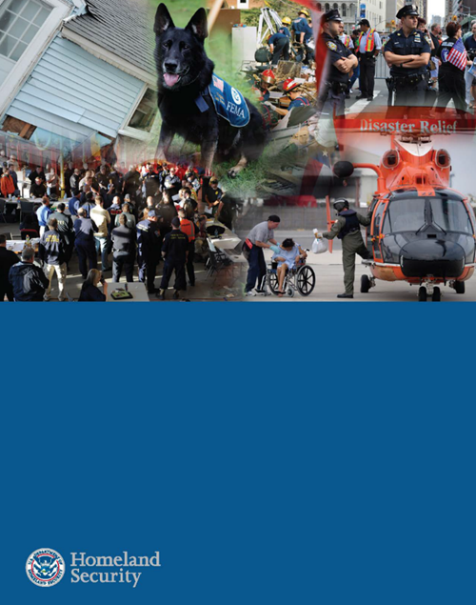
National Response Framework (NRF)
The National Response Framework is a guide to how the Nation responds to all types of disasters and emergencies.
It is built on scalable, flexible, and adaptable concepts identified in the National Incident Management System to align key roles and responsibilities across the Nation.
The National Response Framework describes the principles, roles and responsibilities, and coordinating structures for delivering the core capabilities required to respond to an incident and further describes how response efforts integrate with those of the other mission areas.
This Framework is always in effect and describes the doctrine under which the Nation responds to incidents.
National Response
Framework
Fourth Edition
October 28, 2019
Notes:
Instructor Comments:
The 4th edition of the National Response Framework was published in October 2019. It provides the structure under which the Federal, State and local governments are intended to respond to an emergency or natural disaster.
The National Response Framework covers the capabilities necessary to save lives, protect property and the environment, and meet basic human needs after an incident has occurred. The National Response Framework is built on scalable, flexible, and adaptable concepts identified in the National Incident Management System to align key roles and responsibilities across the Nation.
Response activities take place immediately before, during, and in the first few days after a major or catastrophic disaster. Recovery efforts help the community get back on its feet and focus on how best to restore, redevelop, and revitalize the health, social, economic, natural, and environmental fabric of the community.
Roles and activities found in other Frameworks affect response efforts in many ways. For example, when people proactively do things to lessen the impact of future disasters—as described in the National Mitigation Framework—they may need fewer response resources when a disaster strikes.
The updated National Response Framework incorporates critical edits in the refreshed Nation Preparedness Goal, including lessons learned from real world events and continuing implementation of the National Preparedness System.
Emergency Support Function (ESF) #14 – Cross-Sector Business and Infrastructure was added in this edition. ESF #14 coordinates cross-sector operations with infrastructure owners and operators, businesses, and their government partners, with particular focus on actions taken by businesses and infrastructure owners and operators in one sector to assist other sectors to better prevent or mitigate cascading failures between them. Focuses particularly on those sectors not currently aligned to other ESFs (e.g., the Financial Services Sector).

Slide 9
Notes:
Instructor Comments
The DoD is just part of the team for the Federal response. As you can see, the DoD Rep, the Defense Coordinating Officer (DCO), is part of the Unified Coordination Group. It is through the DCO that requests for DoD support are processed.
Unified Coordination Group (UCG) is composed of senior leaders representing state, tribal, territorial, insular area and federal interests and, in certain circumstances, local jurisdictions, the private sector, and NGOs. UCG members must have significant jurisdictional responsibility and authority. The UCG determines staffing of the unified coordination staff based on incident requirements. The UCG assumes responsibility for coordinating federal response activities at the incident level once unified coordination is established

Slide 10
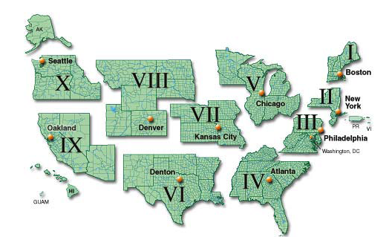
Defense Coordination Officers and FEMA Regions
Notes:
Instructor Comments
Defense Coordinating Officer (DCO) serves as the Department of Defense single point of contact for domestic emergencies who is assigned to a joint field office to process requirements for military support; forward mission assignments through proper channels to the appropriate military organizations; and assign military liaisons, as appropriate, to activated emergency support functions.
There is a DCO assigned to each of the ten FEMA regions. This is the primary duty of the officer assigned, typically an 0-6. During their assignments, these officers should develop relationships with local and State officials, explaining their role. That way, if an event occurs requiring Federal assistance, these relationships will be beneficial.

Slide 11
POSSE COMITATUS ACT
Notes:
Instructor Comments
Now we’ll discuss the Posse Comitatus Act.

Slide 12
Posse Comitatus Act
18 U.S.C. § 1385
Whoever, except in cases and under circumstances expressly authorized by the Constitution or Act of Congress, willfully uses any part of the Army, the Navy, the Marine Corps, the Air Force, or the Space Force as a posse comitatus or otherwise to execute the laws shall be fined under this title or imprisoned for not more than two years, or both.
2
1
4
3
5
Notes:
Instructor Comments
Notice that the PCA is not an absolute bar to DoD enforcing the law. If there is a constitutional or statutory exception, it is authorized. It’s a fairly short, seemingly simple law, but it causes a lot of discussion and is often misunderstood. The starbursts represent the parts of the statute we’ll discuss.

Slide 13
Exceptions
1
Expressly Authorized by Constitution
Art. 2 § 2, Powers as Commander in Chief
Military Purpose Doctrine
  Court-recognized exception
  Primary purpose of furthering a military interest (benefit to civilian authorities is incidental)
    Investigations and enforcement of UCMJ
    Protection of DoD personnel and equipment
Notes:
Instructor Comment:
The first is the Constitutional exception found at Art. 2, Sec. 2, as the President’s powers as Commander in Chief.

Slide 14
Exceptions
1
Expressly Authorized by Constitution
Art. 4 § 4, U.S. shall . . . protect each [State] against invasion; and on Application of the (State) Legislature, or of the Executive (when the Legislature cannot be convened) against domestic violence.
Notes:
Instructor Comments
Also, the Constitution requires the Federal Government protect the States from invasion, and upon request from State officials, protect it from domestic violence. Recognize the requirement for a State request to protect from domestic violence – this is primarily the responsibility of State/local officials. Only upon the request of the State should the Federal Government involve itself in these matters.
The “Executive” as used here means the Governor of the State or Territory. In the case of the District of Columbia, which does not have a Governor, the request comes through the Commanding General of the DC National Guard to the Secretary of the Army or Air Force as the situation warrants. The Commanding General of the D.C. National Guard, a 2-star General Officer, should not be confused with The Adjutant General of the D.C. National Guard, a 1-star General Officer.

Slide 15
Exceptions
2
Expressly Authorized by Congress
Chapter 13, Insurrection
10 U.S.C. §§ 251-255
Permits the use of Federal armed forces or Federalized militia to restore law and order to:
  Support State Request against insurrection (§ 251)
  Enforce Federal Authority or suppress rebellion (§252)
  Protect Constitutional Rights, enforce U.S. law (§253)
Notes:
Instructor Comments:
The Insurrection Statutes found at Chapter 13 of Title 10 are the most widely known and used exceptions to the PCA. Like Art. 4, Section 4, the Federal Government use its armed forces, or Federalize the militia, upon State request if there is an insurrection against the State Government under Section 251.
Under Section 252, the President may unilaterally choose to use the armed forces or the militia to enforce the laws of the United States or suppress a rebellion making it impracticable to enforce those laws.
Finally, under Section 253, the President may unilaterally choose to use the armed forces or the militia to suppress any insurrection, domestic violence, unlawful combination or conspiracy if they hinder the right of the people to exercise their Constitutional rights and State authorities are unable, fail or refuse to protect those rights; or US law cannot be executed.
You can think of this use of unilateral authority for enforcement of US law (integration) in (1) use of the 101st AB DIV to escort students to class in Little Rock, Ark., in the late 50’s (The Little Rock Nine); and (2) the University of Alabama in the early 60’s (Gov. Wallace standing in the Foster Auditorium door) as members of the ALARNG were Federalized under the President’s authority and then asked the Governor to “step aside” as they were there to enforce Federal law to allow for the integration of the University.
There are also other limited exceptions found within other individual statutes. You can find those listed in DoDI 3025.21.

Slide 16
APPLICATION
3
Who
  Active duty Army, Navy, Marine Corps, Air Force, and Space Force
What about Reserve?
What about National Guard?

Slide 17
Army or Air Force
3
Reservists and National Guard?
  Reservists (USAR, USNR, USMCR, USAFR): YES, if serving in a duty status (Reservists serve only in Federal, Title 10, status).
  National Guard: NO, if under State control in Title 32 or State Active Duty status. YES, if in Federal (Title 10) status.

Slide 18
Navy, Marine Corps?
  Active duty Navy/Marines?
    Courts: No
    Congress: No, but . . .
      1981, 10 U.S.C. § 275 required DoD prescribe regs applicable to Army, Navy
      Air Force, or Marine Corps
      PCA applies to Navy/Marines through policy
Notes:
Instructor Comments
While the PCA does not list the Navy or USMC, Congress required in 1981, through 10 USC § 275, that DoD prescribe regs applying to all services disallowing direct participation in law enforcement activities. This is where DoDD 3025.18, Defense Support of Civil Authorities, and DoDI 3025.21, Defense Support of Civilian Law Enforcement Agencies, come into play.
PCA was updated in 2021 to explicitly include Navy, Marines, and Space Force, so it’s no longer applied just via policy.

Slide 19
Posse Comitatus to Execute the Laws?
4
10 U.S.C. § 275 requires DoD prescribe regs ensuring no “direct participation” in search, seizure, arrest, or similar activity unless otherwise authorized by law
DoDI 3025.21: prohibits direct assistance to civilian law enforcement officials
  What is direct assistance…
Notes:
Instructor Comments
The law at 10 USC § 275 prohibits direct participation; in the DoDI, direct participation also called direct assistance.

Slide 20
Posse Comitatus Act
5
Effects of violation
  Fine
  Imprisonment for not more
  than two years, or both
  No history of prosecution
Notes:
Instructor Comments
Although there is no history of prosecution under the PCA, a violation of the PCA may arise in the context of a criminal prosecution in the courtroom. For example, a defendant may allege that evidence being used against them was obtained in violation of the PCA. As a result, a defendant may argue that any such evidence be excluded from consideration.

Slide 21
Posse Comitatus Act
5
Effects of violation
  Exclusionary Rule
  Failure to prove an element
  Dismissal of charges
Notes:
Instructor Comments
Individuals love to hang their hats on the November 2015 case, U.S. v Dreyer.
Background: Following denial of his motion to suppress evidence seized from his residence and computer, defendant was convicted after jury trial in the United States District Court for the Western District of Washington, Marsha J. Pechman, Chief Judge, of distributing child pornography, and possessing child pornography. Defendant appealed. After a panel of the Court of Appeals reversed and remanded, 767 F.3d 826, rehearing en banc was granted, 782 F.3d 416.
Holdings: On rehearing en banc, the Court of Appeals, Christen, Circuit Judge, held that:
1: Posse Comitatus Act (PCA)-like restrictions on military personnel providing direct assistance to civilian law enforcement apply to the Naval Criminal Investigative Service (NCIS) and its civilian agents;
2: NCIS special agent violated the PCA-like restrictions in conducting this investigation; but
3: Suppression was not warranted to deter future violations.
However, we should be careful to note that all cases involving exclusion of evidence or dismissal of charges do not turn on the same set of facts as Dreyer. Take the June 1981 case, People v. Blend, 121 Cal App 3d 215, 224 (June 30, 1981), for instance.
Synopsis: Defendant was convicted before the Superior Court, Kings County, Charles W. Jennings, J., of two counts of selling cocaine, and he appealed. The Court of Appeal, Fifth District, Pauline Davis Hanson, J., held that: (1) activity of Wave, in setting up transaction in which member of sheriff's narcotics task force bought cocaine from defendant at Naval air station, did not violate Posse Comitatus Act; (2) mere fact that Naval investigative service provided such member with passes to enter station did not violate the Act; (3) fact that tape recordings of telephone conversations between Wave and defendant and between the member of the force and defendant were not made with his consent did not preclude their admission into evidence; (4) in regard to contention that a conversation between Wave and defendant was overheard and recorded illegally because Wave's consent was involuntary, Wave's cooperation was not “coerced” merely because she found it to be in her own best interest to cooperate with those enforcing the law; and (5) defendant, who alleged discriminatory prosecution due to his refusal to turn informant, failed to establish a claim of discriminatory enforcement, in view of his failure to demonstrate that he had been deliberately singled out for prosecution on basis of some invidious criterion. (Note: Dylan Gray, a female operator, was a “Wave” stationed at Lemoore Naval Air Station during this case)
Judgment affirmed.
Also consider United States v. Red Feather, 392 F.Supp. 916 (April 7, 1975)
Synopsis: Government, which had charged numerous defendants with interfering with law enforcement officers engaged in the lawful execution of their duties in connection with take-over of village of Wounded Knee, sought order prohibiting defendants from making any statements about certain activities of Department of Defense and military personnel during the occupation. The District Court, Bogue, J., held that government had burden of proving beyond a reasonable doubt that, inter alia, law enforcement officers were engaged in the lawful performance of their duties; that evidence that United States marshals or agents of the FBI violated defendant's constitutional rights would be admissible on that issue; that evidence that military personnel took an active role in direct law enforcement during the occupation would be admissible on that issue, as such activities are unlawful; but that evidence that military engaged in passive role which might have indirectly aided law enforcement officials, such as by supplying material or making aerial reconnaissance flights, would not be evidence of unlawful conduct and would be irrelevant to determination of whether law enforcement officers were lawfully engaged in the execution of their duties.
Ordered accordingly.

Slide 22
Defense Support of Civil Authorities
(DSCA) DoDD 3025.18
Law
Enforcement
Civil
Disturbances
Emergencies
Notes:
Instructor Comments
DoDD 3025.18 and DoDI 3025.21 resulted from the legislation at 10 USC § 275.

Slide 23
DoDD 3025.18
Governs all DoD military assistance to civil authorities
Evaluation criteria for requests (CARRLL Factors)
  Cost: Who pays; impact on DoD budget.
  Appropriateness: Whether the requested mission is in the interest of DoD to conduct.
  Risk: Safety of DoD Forces.
  Readiness: Impact on DoD’s ability to perform its primary mission.
  Legality: Compliance with laws.
  Lethality: Potential need for lethal force by or against DoD Forces.

Slide 24
UMBRELLA
Defense Support
of Civil Authorities
Law Enforcement
DoDI 3025.21
Civil
Disturbances
Emergencies

Slide 25
DoDI 3025.21 –
Direct Assistance
4
Defines prohibited direct assistance as:
    Interdiction
    Search or seizure
    Arrest, apprehension, stop and frisk
    Use of personnel – surveillance or pursuit of individuals, or as undercover agents, informants, investigators, interrogators

Slide 26
Indirect Assistance
10 U.S.C. Chapter 15 (§§ 271-284)
Military Support for Civilian Law Enforcement Agencies
Information sharing
Use of military equipment
Training and advising (basic v. advanced military skills)
Maintenance and operation of equipment
WMD support
        ** approval authority varies
Notes:
Instructor Comments
While we’ve discussed those exceptions to the PCA, chapter 15 does not provide for “exceptions” to the PCA, as it allow for “support” of civilian law enforcement. There is a difference between “direct participation,” which is unauthorized unless an exception applies, versus support.
POLICY GUIDANCE BY DEP SECDEF (1996): Basic military skills training, such as basic marksmanship, patrolling, medical/combat lifesaver, mission planning, and survival skills are OK. Provision of advanced military training is prohibited. Advanced military training is defined as high intensity training which focuses on the tactics, techniques, and procedures (TTPs) required to apprehend, arrest, detain, search for, or seize a criminal suspect when the potential for a violent confrontation exist.
EXAMPLES OF ADVANCED MILITARY TRAINING: sniper trng., MOUT, and close quarter/battle
EXCEPTION: Training at the MP school. The CDR SOCOM may approve this training.
USE OF MIL EQUIPMENT AND FACILITIES: Section 272 allows the DoD to make available any equipment (including associated supplies or spare parts), base facility, or research facility of the Department of Defense to any Federal, State, or local civilian law enforcement official for law enforcement purposes.
ADVICE: Section 273 allows provision of expert advice, but regular or direct involvement by Federal military personnel in the law enforcement activity is prohibited.
EXAMPLE: Military working dog team – can provide dog (equipment) and handler (advice)…however, Federal military personnel cannot directly participate in the performance of local law enforcement activities such as drug sweeps.
APPROVAL AUTHORITY = SECDEF if assignments of 50 or more DoD employees, or if advice will be used by LEA against specifically identified individuals or groups.
REIMBURSEMENT: Economy Act for Federal agencies, unless the support is provided in normal course of training or ops, or support results in substantially equivalent training value.

Slide 27
Support to Law
Enforcement FUNDING
Reimbursable UNLESS:
  Provided in the normal course of training or operations; OR
  The support results in substantially equivalent training value

Slide 28
UMBRELLA
Defense Support
of Civil Authorities
Law
Enforcement
Civil
Disturbances
DoDI 3025.21
Emergencies

Slide 29
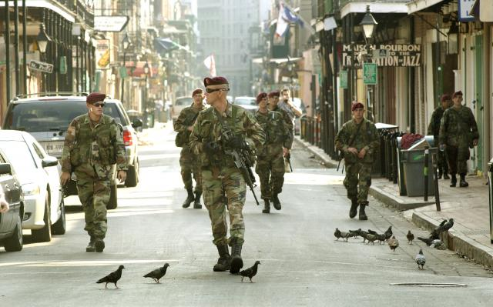
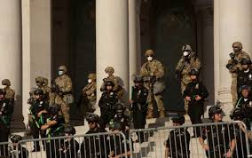
Civil Disturbances
President’s Authority:
  Constitution
    Art. 4 § 4
  Insurrection Act
    10 U.S.C. §§ 251-255
DoD Authority:
  DoDD 3025.18; DoDI 3025.21
  DOJ in charge
  ASD/HD&ASA Exec. Agent
  Emergency Authority
Notes:
Instructor Comments
Exception to PCA. In this case, the government of California requested the Federal Government send in its military forces to help restore law and order. The California National Guard was Federalized; therefore, they fell under control of POTUS versus the Governor of California.
ASD/HD&ASA = Assistant Secretary of Defense for Homeland Defense and Americas’ Security Affairs

Slide 30
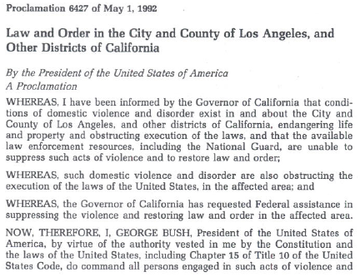
President George H.W. Bush
Notes:
Instructor Comments
Here is the Proclamation required under Section 254 of the Insurrection Statutes – the Riot Act – prior to the use of Federal military personnel.

Slide 31
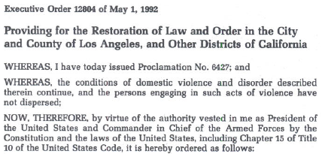
Units and members of U.S. Armed Forces and Federal Law Enforcement Officers will be used to suppress violence and restore law and order.
SecDef may use the active forces and may Federalize NG. SecDef will follow LE policies as the Attorney General (AG) may determine.
The AG is authorized to coordinate activities of all assisting Federal agencies.
SecDef may determine when Federal military members shall be withdrawn.
Notes:
Instructor Comments:
This is the executive order sending in Federal troops.

Slide 32
DoD Response to Civil Disturbances
SECDEF is approval authority
Civil Authorities have primary responsibility, but military forces remain under military command and control
Emergency employment of military forces
  Prevent loss of life or wanton destruction
  Protect Federal property or Federal Government functions
Notes:
Instructor Comments
Insurrection within State, legislature or Governor request assistance.
Rebellion making it impossible or impracticable to enforce Federal law or State law; State isn’t providing protection of rights.

Slide 33
UMBRELLA
Defense Support
of Civil Authorities
Law
Enforcement
Civil
Disturbances
EMERGENCIES
DoDD 3025.18

Slide 34
DISASTER/EMERGENCY
The Stafford Act
Presidential Action
10-day window
Declaration of
a major disaster
Declaration of
an emergency
Notes:
Instructor Comments
Major disaster – natural catastrophe with damage significant enough to warrant disaster assistance – requires request from Governor, State executed plan, State will cost share
Emergency – necessary to save lives and protect property, health safety – same requirements but State must specify dollar amount and assistance needed.
Operationally no different. The bottom line is that a Stafford Act Declaration IS NOT an exception to the PCA.
The President can send in Federal assets (troops) for 10 days prior to a declaration.

Slide 35
Types of Support
Personnel, equipment, supplies, facilities, and advisory services
Lending equipment
Services essential to saving lives and protecting/preserving property, public health, and safety…
Notes:
Instructor Comments
These are the types of support authorized for a Stafford Act response – basically coming out of Chapter 15, Title 10, discussed earlier.

Slide 36
Immediate Response Authority
Authority – DoDD 3025.18
Authorizes local military commanders to take action to save lives, prevent human suffering, or mitigate great property damage
  Imminently serious conditions
  Time does not permit approval from higher HQ
  Cannot perform law enforcement functions
Notes:
Instructor Comments
Immediate Response Authority is that authority where a local commander can respond to an event close by their installation, etc. Immediate Response authority is authorized, but is not an exception to PCA.

Slide 37
Immediate Response Authority
Higher HQ
HELP !
CONUS
REPORT
CIVIL
AUTHORITY
LOCAL
COMMANDER
    - SAVE LIVES
    - PREVENT HUMAN SUFFERING
    - MITIGATE GREAT PROPERTY DAMAGE
DISASTER
SITE
ISSUES:
72 HOURS
REPEATED USE
PERSONNEL/ RESOURCES
Notes:
Instructor Comments
Must first have request from civil authority. Under immediate response authority (IRA), DoD assistance must be requested from a civilian authority. There is a “rule of thumb” of 72 hours meaning if 72 hours have passed since using IRA, there is a need to reassess the emergency nature of the situation to determine whether the assistance provided still qualifies as an “immediate response”. Other civilian responders should have come by this time – unless it’s something that only we can provide – for example, WMD or CBRN response capabilities.

Slide 38
Immediate Response Authority
Support authorized includes:
  Rescue, evacuation, emergency treatment of casualties
  Emergency restoration of power, water, transportation
  Food distribution
Provided on a cost-reimbursable basis
Notes:
Instructor Comments
Debris removal, search and rescue, clearing roads, etc.
FEMA directs Federal response. SecArmy is no longer exec agent for disaster relief, it’s now ASD(HD&ASA) (Assistant Secretary of Defense for Homeland Defense and Americas’ Security Affairs). JDOMS (Joint Directorate of Military Support) is action agent for ASD (HD&ASA).

Slide 39
Key Takeaways
Involvement by DoD in any domestic affair is the exception to the general rule
DoD’s involvement in DSCA is tightly controlled by statute and regulation
DoD will usually be subordinate to other civilian authority
Notes:
Instructor Comments
These are the overarching principles when discussing DSCA

Slide 40
QUESTIONS?
Notes:
Instruction Note:
Questions or comments about this briefing may be referred to the Educational Technology Distributed Learning Division, The Judge Advocate General’s Legal Center and School by going to https://jagu.army.mil and submitting a helpdesk ticket.

